Slide 1
Chapter 8 :Python Lists
Amni Saizan

Slide 2

A List is a kind of Collection
A collection allows us to put many values in a single “variable”
A collection is nice because we can carry all many values around in one convenient package.
friends = [ 'Joseph', 'Glenn', 'Sally' ]
carryon = [ 'socks', 'shirt', 'perfume' ]

Slide 3
What is not a “Collection”
Most of our variables have one value in them - when we put a new value in the variable - the old value is over written
$ python
Python 2.5.2 (r252:60911, Feb 22 2008, 07:57:53)
[GCC 4.0.1 (Apple Computer, Inc. build 5363)] on darwin
>>> x = 2
>>> x = 4
>>> print x
4

Slide 4
List Constants
List constants are surrounded by square brakets and the elements in the list are separated by commas.
A list element can be any Python object - even another list
A list can be empty
>>> print [1, 24, 76]
[1, 24, 76]
>>> print ['red', 'yellow', 'blue']
['red', 'yellow', 'blue']
>>> print ['red', 24, 98.6]
['red', 24, 98.599999999999994]
>>> print [ 1, [5, 6], 7]
[1, [5, 6], 7]
>>> print []
[]

Slide 5
We already use lists!
5
4
3
2
1
Blastoff!
for i in [5, 4, 3, 2, 1] :
print i
print 'Blastoff!'

Slide 6
Lists and definite loops - best pals
friends = ['Joseph', 'Glenn', 'Sally']
for friend in friends :
print 'Happy New Year:', friend
print 'Done!'
Happy New Year: Joseph
Happy New Year: Glenn
Happy New Year: Sally
Done!

Slide 7

Looking Inside Lists
Just like strings, we can get at any single element in a list using an index specified in square brackets
>>> friends = [ 'Joseph', 'Glenn', 'Sally' ]
>>> print friends[1]
Glenn
>>>
Joseph
Glenn
Sally
0
1
2

Slide 8
Lists are Mutable
>>> fruit = 'Banana’
>>> fruit[0] = 'b’
Traceback
TypeError: 'str' object does not
support item assignment
>>> x = fruit.lower()
>>> print x
banana
>>> lotto = [2, 14, 26, 41, 63]
>>> print lotto
[2, 14, 26, 41, 63]
>>> lotto[2] = 28
>>> print lotto
[2, 14, 28, 41, 63]
Strings are "immutable" - we cannot change the contents of a string - we must make a new string to make any change
Lists are "mutable" - we can change an element of a list using the index operator

Slide 9
How Long is a List?
The len() function takes a list as a parameter and returns the number of elements in the list
Actually len() tells us the number of elements of any set or sequence (i.e. such as a string...)
>>> greet = 'Hello Bob’
>>> print len(greet)
9
>>> x = [ 1, 2, 'joe', 99]
>>> print len(x)
4
>>>

Slide 10
Using the range function
The range function returns a list of numbers that range from zero to one less than the parameter
We can construct an index loop using for and an integer iterator
>>> print range(4)
[0, 1, 2, 3]
>>> friends = ['Joseph', 'Glenn', 'Sally']
>>> print len(friends)
3
>>> print range(len(friends))
[0, 1, 2]
>>>

Slide 11
A tale of two loops...
>>> friends = ['Joseph', 'Glenn', 'Sally']
>>> print len(friends)
3
>>> print range(len(friends))
[0, 1, 2]
>>>
friends = ['Joseph', 'Glenn', 'Sally']
for friend in friends :
print 'Happy New Year:', friend
for i in range(len(friends)) :
friend = friends[i]
print 'Happy New Year:', friend
Happy New Year: Joseph
Happy New Year: Glenn
Happy New Year: Sally

Slide 12
Concatenating lists using +
We can create a new list by adding two exsiting lists together
>>> a = [1, 2, 3]
>>> b = [4, 5, 6]
>>> c = a + b
>>> print c
[1, 2, 3, 4, 5, 6]
>>> print a
[1, 2, 3]

Slide 13
Lists can be sliced using :
>>> t = [9, 41, 12, 3, 74, 15]
>>> t[1:3]
[41,12]
>>> t[:4]
[9, 41, 12, 3]
>>> t[3:]
[3, 74, 15]
>>> t[:]
[9, 41, 12, 3, 74, 15]
Remember: Just like in strings, the second number is "up to but not including"

Slide 14
List Methods
>>> x = list()
>>> type(x)
<type 'list'>
>>> dir(x)
['append', 'count', 'extend', 'index', 'insert', 'pop', 'remove', 'reverse', 'sort']
>>>
http://docs.python.org/tutorial/datastructures.html

Slide 15
Building a list from scratch
We can create an empty list and then add elements using the append method
The list stays in order and new elements are added at the end of the list
>>> stuff = list()
>>> stuff.append('book')
>>> stuff.append(99)
>>> print stuff
['book', 99]
>>> stuff.append('cookie')
>>> print stuff
['book', 99, 'cookie']

Slide 16
Is Something in a List?
Python provides two operators that let you check if an item is in a list
These are logical operators that return True or False
They do not modify the list
>>> some = [1, 9, 21, 10, 16]
>>> 9 in some
True
>>> 15 in some
False
>>> 20 not in some
True
>>>

Slide 17
A List is an Ordered Sequence
A list can hold many items and keeps those items in the order until we do something to change the order
A list can be sorted (i.e. change its order)
The sort method (unlike in strings) means "sort yourself"
>>> friends = [ 'Joseph', 'Glenn', 'Sally' ]
>>> friends.sort()
>>> print friends
['Glenn', 'Joseph', 'Sally']
>>> print friends[1]
Joseph>>>

Slide 18
Built in Functions and Lists
>>> nums = [3, 41, 12, 9, 74, 15]
>>> print len(nums)
6
>>> print max(nums)
74
>>> print min(nums)
3
>>> print sum(nums)
154
>>> print sum(nums)/len(nums)
25
There are a number of functions built into Python that take lists as parameters
Remember the loops we built? These are much simpler
http://docs.python.org/lib/built-in-funcs.html

Slide 19
Enter a number: 3
Enter a number: 9
Enter a number: 5
Enter a number: done
Average: 5.66666666667
total = 0
count = 0
while True :
inp = input('Enter a number: ')
if inp == 'done' :
break
value = float(inp)
total = total + value
count = count + 1
average = total / count
print 'Average:', average
numlist = list()
while True :
inp = input('Enter a number: ')
if inp == 'done' :
break
value = float(inp)
numlist.append(value)
average = sum(numlist) / len(numlist)
print 'Average:', average

Slide 20
Best Friends: Strings and Lists
>>> abc = 'With three words’
>>> stuff = abc.split()
>>> print stuff
['With', 'three', 'words']
>>> print len(stuff)
3
>>> print stuff[0]
With
>>> print stuff
['With', 'three', 'words']
>>> for w in stuff :
... print w
...
With
Three
Words
>>>
Split breaks a string into parts produces a list of strings. We think of these as words. We can access a particular word or loop through all the words.

Slide 21
>>> line = 'A lot of spaces’
>>> etc = line.split()
>>> print etc
['A', 'lot', 'of', 'spaces']
>>>
>>> line = 'first;second;third’
>>> thing = line.split()
>>> print thing
['first;second;third']
>>> print len(thing)
1
>>> thing = line.split(';')
>>> print thing['first', 'second', 'third']
>>> print len(thing)
3
>>>
When you do not specify a delimiter, multiple spaces are treated like “one” delimiter.
You can specify what delimiter character to use in the splitting.

Slide 22
From stephen.marquard@uct.ac.za Sat Jan 5 09:14:16 2008
fhand = open('mbox-short.txt')
for line in fhand:
line = line.rstrip()
if not line.startswith('From ') : continue
words = line.split()
print words[2]
Sat
Fri
Fri
Fri
...
>>> line = 'From stephen.marquard@uct.ac.za Sat Jan 5 09:14:16 2008’
>>> words = line.split()
>>> print words
['From', 'stephen.marquard@uct.ac.za', 'Sat', 'Jan', '5', '09:14:16', '2008']
>>>

Slide 23
The Double Split Pattern
Sometimes we split a line one way and then grab one of the pieces of the line and split that piece again
From stephen.marquard@uct.ac.za Sat Jan 5 09:14:16 2008
stephen.marquard@uct.ac.za
words = line.split()
email = words[1]
pieces = email.split('@')
print pieces[1]
['stephen.marquard', 'uct.ac.za']
'uct.ac.za'

Slide 24
The Double Split Pattern
Sometimes we split a line one way and then grab one of the pieces of the line and split that piece again
From stephen.marquard@uct.ac.za Sat Jan 5 09:14:16 2008
stephen.marquard
uct.ac.za
words = line.split()
email = words[1]
pieces = email.split('@')
print pieces[1]
stephen.marquard@uct.ac.za
['stephen.marquard', 'uct.ac.za']
'uct.ac.za'

Slide 25
The Double Split Pattern
Sometimes we split a line one way and then grab one of the pieces of the line and split that piece again
From stephen.marquard@uct.ac.za Sat Jan 5 09:14:16 2008
words = line.split()
email = words[1]
pieces = email.split('@')
print pieces[1]
stephen.marquard@uct.ac.za
['stephen.marquard', 'uct.ac.za']
'uct.ac.za'

Slide 26
The Double Split Pattern
Sometimes we split a line one way and then grab one of the pieces of the line and split that piece again
From stephen.marquard@uct.ac.za Sat Jan 5 09:14:16 2008
words = line.split()
email = words[1]
pieces = email.split('@')
print pieces[1]
stephen.marquard@uct.ac.za
['stephen.marquard', 'uct.ac.za']
'uct.ac.za'

Slide 27
Task 3 (lab task)
Apply these methods in your code
List Method: | Description:
List.append(x) | Adds item x to the end of the list
List.extend(L) | Adds all items in list L to the end of the list
List.insert(i,x) | Inserts item x at index position i
List.remove(x) | Removes first item x from the list
List.pop(i) | Removes item at index position i and returns it.
List.index(x) | Returns the index position in the list of first item x
List.count(x) | Returns the number of times x appears in the list
List.sort() | Sort all items in the first place
List.reverse() | Reverse all list items, in place

Slide 28
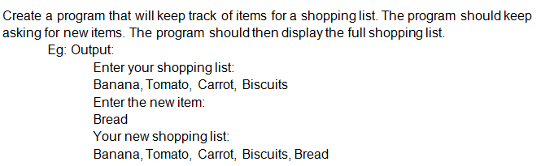
Task 1

Slide 29
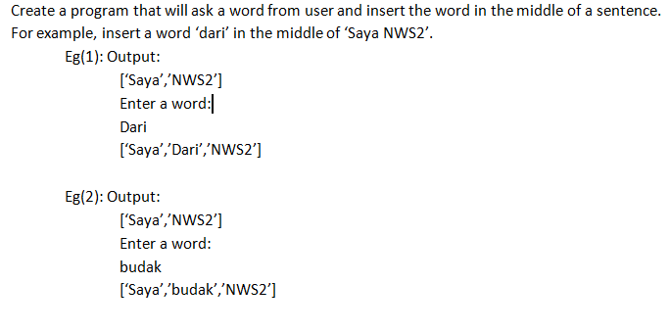
Task 2

Slide 30
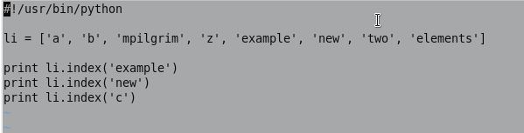
Task 4
Give the output for this program.

Slide 31
Task 5
Create a list of names and with the list that is created, update the list by replacing Ahcong and Mael into numbers.
Output:
Old list: [‘ali’, ‘amat’, ‘ahcong’, ‘mael’]
New list: [‘ali’, ‘amat’, 3, 4]

Slide 32
List Summary
Concept of a collection
Lists and definite loops
Indexing and lookup
List mutability
Functions: len, min, max, sum
Slicing lists
List methods: append, remove
Sorting lists
Splitting strings into lists of words
Using split to parse strings

Slide 33
Reference
Python for Informatics: Exploring Information
www.pythonlearn.com

